Slide 2
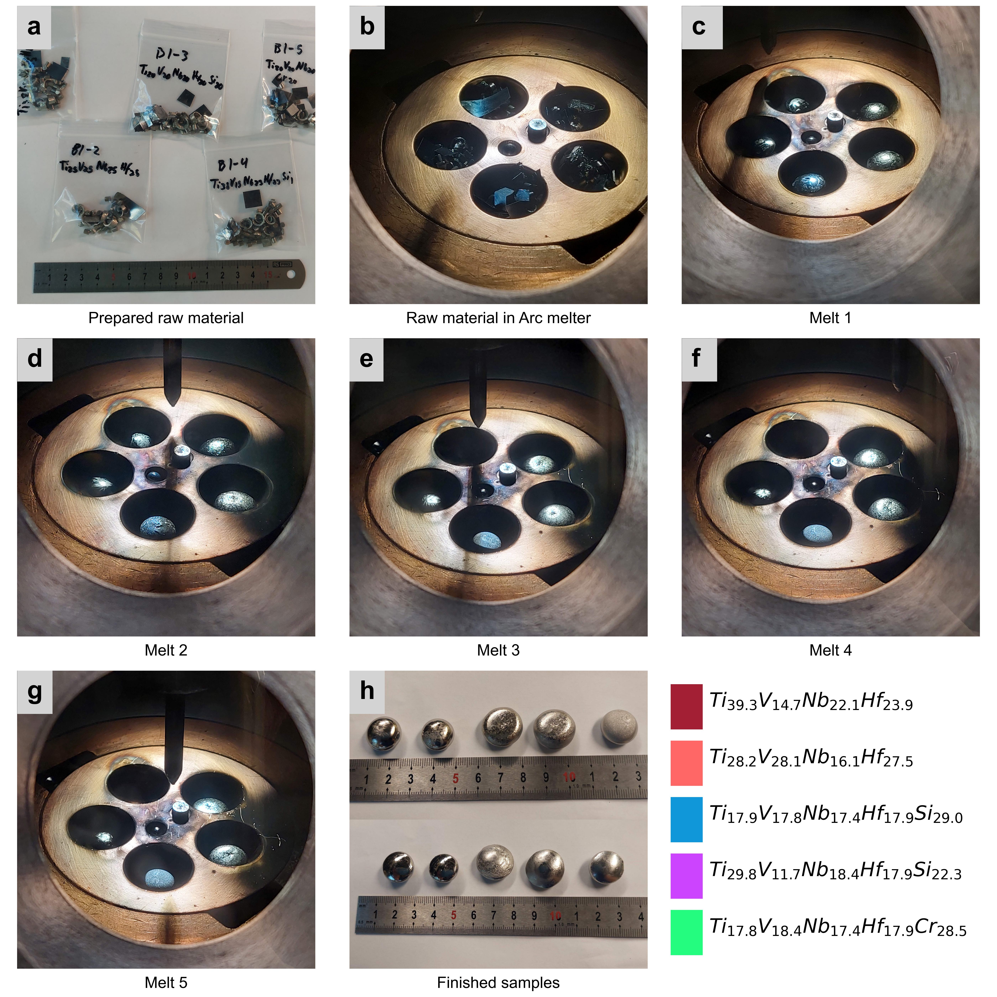
Facing chamber
Facing Crucible

